Slide 1


What is the

Slide 2





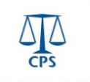

The Civil Service is made up of many departments. This presentation will focus on the following departments:
Notes:
The civil service is made up of:
24 ministerial departments – a few examples you may of heard of are: Department of Education; Ministry of Defence, Cabinet Office and HM Treasury
22 non-ministerial departments – a few examples you may of heard of are: National Savings and Investments, National Crime Agency and Ofsted
379 agencies and other public bodies – a few examples you may of heard of are: Foreign and Commonwealth Services; Metropolitan Police Office; NHS England.
Source: https://www.gov.uk/government/organisations
The Civil Service also includes the Prime Minister’s Office and the Deputy Prime Minister’s Office.
When you pay taxes you help pay for civil servants.

Slide 3
But what do they all do?
Does anyone here know?
Maybe someone you know is a Civil Servant without you even realising it!
We know someone who can help clear things up.

Slide 4
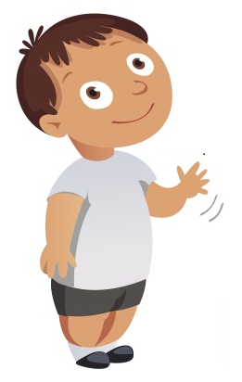
Meet Cyril Service
Let’s start from the beginning…

Slide 5
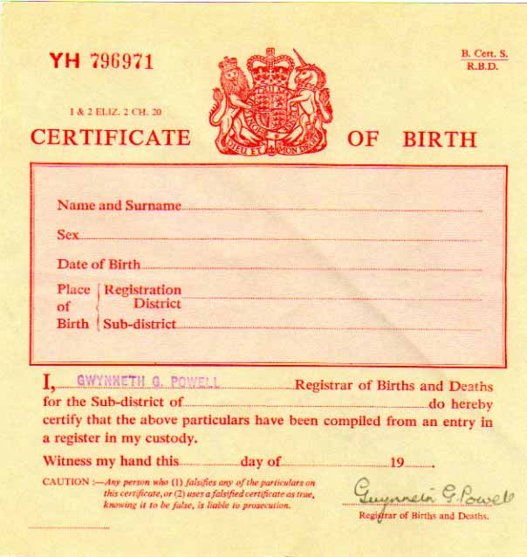
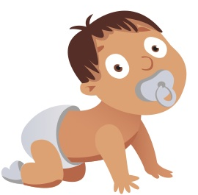
Baby Cyril is born!
What happens now?
Cyril’s parents register his birth.
They claim for Child Benefit.
At 15 years & 9 months old, he receives a National Insurance (NI) number - This is kept in a safe place for him to use in future.
Notes:
A National Insurance Number will always be 2 letters 6 numbers and a final letter e.g. AA123456A. You might see a National Insurance Number that is 2 numbers 1 letter and then more numbers e.g. 22y12345, this is a temporary National Insurance Number.
· If you turned 16 and didn’t get a number – you should be sent a National Insurance number automatically just before your 16th birthday if you live in the UK. Call the National Insurance numbers helpline (0300 200 3500) if you didn’t get one and you’re under 20. If you’re over 20 and haven’t been sent one, call the Jobcentre Plus application line (0345 600 0643).
If you’ve lost your National Insurance number, you may be able to find it on your payslips, P60, letters about tax, pensions and benefits. If you have a personal tax account (https://www.gov.uk/personal-tax-account) you can also view it there. If you still can’t find it, fill in form CA5403 (https://www.gov.uk/lost-national-insurance-number) or call the National Insurance numbers helpline.
· Working without a National Insurance number – you can start work before your National Insurance number arrives. You should tell your employer that you’ve applied for one and give it to them when you have it. All info can be found under https://www.gov.uk/apply-national-insurance-number

Slide 6
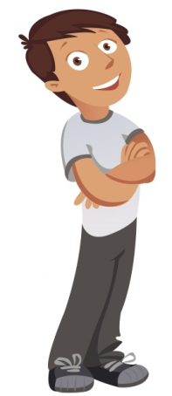

Student Cyril
What happens now?
Now Cyril has his National Insurance number he can apply for his provisional driving license and student finances.
He can use it to apply for part time work.
Notes:
National Insurance Number’s are needed to claim student finance, work legally in the UK and claim state benefits.
Some employers are now asking to see the National Insurance letter as proof they have one, keep in a safe place as it costs money to issue a replacement.
As in the previous slide you can commence work without a National Insurance Number, but you should advise you have applied or asked for it.
Cyril uses his National Insurance Number to apply for his provisional driving license – this is only applicable if they apply online, if they have not got one they send in an application form obtained from the post office and sent to the DVLA (another government department).

Slide 7
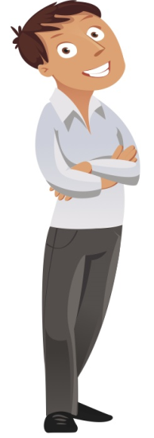

Cyril wants a job!
What happens now?
Cyril goes to the Job Centre where he is allocated a Work Coach to help him write a CV and apply for jobs.
They help him find work experience to improve his CV.
They arrange mock interviews with him, to help him practice.
They help him apply for Jobseekers Allowance /Universal Credit.
Notes:
When you attend the Jobcentre you are allocated a Work Coach who will help you to look for and find a job.
Your Work Coach will advise you of vacancies, work experience or courses you can apply for.
If you have any disabilities you can also see the Disability Employment Advisor who can give you more support in your journey into work.

Slide 8
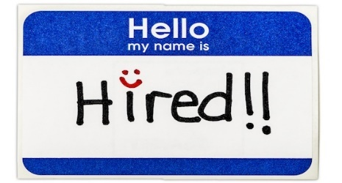
Cyril gets a job!
What happens now?
Cyril signs up for his Personal Tax Account, where he can check his Tax Code, Income and National Insurance contributions.
Cyril will pay tax on his income if his pay is over a certain amount
He may receive Working Tax Credits/Universal Credit if his pay is under a certain amount.
Notes:
You can find a link to the PTA (Personal Tax Account) at www.gov.uk under popular links.
· Income tax rates tend to change yearly. 17/18 Personal Allowance is £11,500.
· Personal Allowance is the amount of tax free money you can earn in a year.
· Tax Rates on what you earn are the following:
· 20% if you earn up to £33,500
· 40% if you earn between £33,501 – £150,000
· 45% if you earn over £150,001.
National Insurance contributions are 12% over the £157 per week £680 per month £8,164 (you pay 12% National Insurance if you are paid either 157 per week, 682 per month or 8164 per year E.G you are paid £800 you subtract £680 to get £120 and multiply by 0.12 you get 14.40. This means you will pay £14.40 in NI) or you can go to http://nicecalculator.hmrc.gov.uk/Errors/SessionEnded.aspx this will work out your NI.
· All figures applicable to tax year 17/18.
*These figures will need to be updated each year.*

Slide 9


What if Cyril received a conditional offer of employment with
DWP Digital?
What happens now?
Cyril goes through pre employment checks.
He receives an email to complete a security questionnaire online.
Once checks are completed a formal offer and start date can be agreed.
He is given an induction upon joining DWP Digital and the Civil Service.
Notes:
Once successfully applying and passing the interview stage, pre employment checks would start. These include checking references, seeing if you have worked at a previous civil service department (e.g. dismissed from a previous department, left before or while under investigation or recently made redundant), any fraud convictions, checks with the disclosure and barring service if working with children.
DWP Digital conduct user research from our customers to design, develop and test digital applications to meet the Government’s objective of the Civil Service Digital by default strategy (could this be explained a bit more?). They use system analysis to monitor and develop services. Other departments within the Civil Service also have their own digital teams.
There are a variety of different digital roles which are not software development.

Slide 10
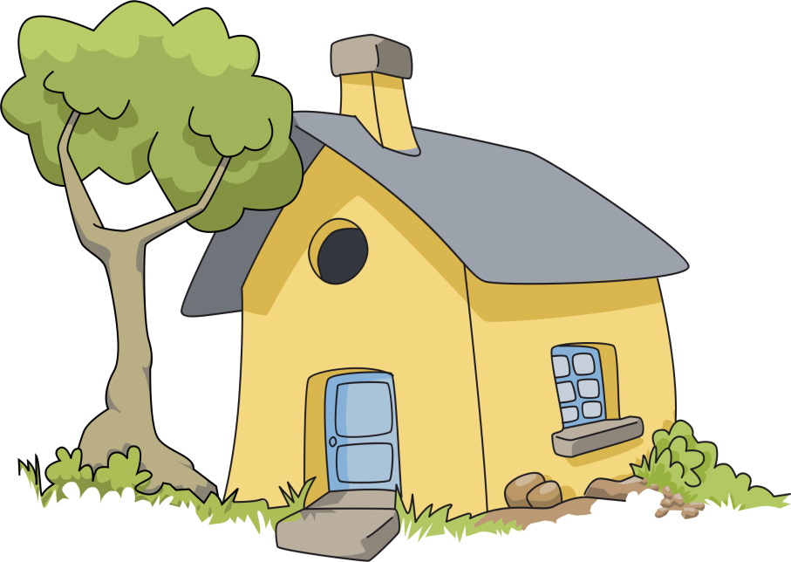

Cyril Buys a House
What happens now?
If he needed to, Cyril would apply for a mortgage.
He picks his house and instructs a solicitor.
Solicitors do checks on the house through Land Registry and lodge an application to transfer.
Once the house is transferred over, Cyril is then the Registered Owner.
Notes:
When the solicitors do the checks they will need official copies of the documents to see what restrictions are on the land and to find the extent of the land. Official Copies are an updated version of the deed. Deeds are what were kept years ago to show you owned the property and gave a brief outline of your boundaries. When Solicitors receive the official copies, they will also see if there is a mortgage still on the register, and from there they will have to get in contact with the bank to try and get this removed before “Cyril” comes on to the register.
Within the Land Registry there are jobs for people to process these simple types of applications to get them sent out to the solicitors ready for the next step.
Ordinary Citizens can get Official Copies from our website too if they weren’t going through a solicitor and you can get copies of any house within England and Wales.
Solicitors lodge the application to the Land Registry to transfer the land from the current owner to “Cyril”. When this goes in, Caseworkers form the Land Registry can begin processing the Transfer, adding on any mortgages going onto the register Updating it so it is in the new owner, “Cyril’s” name.

Slide 11

Cyril has a Family!
What happens now?
Cyril speaks to a Contact Centre Agent to make claims for Child Benefit and Child Tax Credits/Universal Credit to help him pay for childcare.
If Cyril lost his job or became a single parent he may be entitled to further support.
Notes:
If Cyril separates from his partner he will do the following actions:
Logs on to gov.uk to learn how to apply for a divorce.
He also logs on to cmoptions.org to look at options for paying Child Maintenance
These options are: Family based arrangement, Statutory child maintenance arrangements, Consent orders (a type of court order in England and Wales) and Minute of agreement (in Scotland)
Cyril would pay Child Maintenance until his children leave school education or he becomes the main caregiver

Slide 12

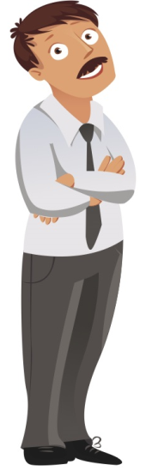



Cyril goes abroad on Holiday!
What happens now?
Cyril logs on to gov.uk to learn how to apply for a passport for himself and his family.
He completes the online forms, pays the relevant fees and posts the required documents to support the applications.
They receive their passports and go on holiday.
Notes:
Cyril will need to provide evidence his claim to British nationality by verifying his claim under the British Nationality Act 1981 (BNA 81).
As Cyril was born before 1983, all he needs to do is obtain his Full Birth Certificate from the General Register Office as this will establish he is British by virtue of being born in the UK.
As this will be his first passport he will also have to attend an identity interview.
The process will be slightly different for anyone born after 1983 as different criteria will apply depending on the circumstances of each applicant.
Adult passport applications cost £72.50 and Child Applications cost £46.00.
If Cyril is applying for himself, his partner and his two children – the total cost will be £237 via the standard process.
Cyril can expect his passport in around six weeks (including time to apply, attend interview).

Slide 13


Cyril is Arrested.
What happens now?
Cyril is found to be driving a stolen car (albeit unawares!)
Police submit file to Crown Prosecution Service (CPS).
The CPS review the file in accordance with the Code for Crown Prosecutors and decide whether to prosecute Cyril.
The CPS decide not to prosecute Cyril.
Notes:
Once the Police have finished their investigation, they can submit case papers to the CPS electronically. The file submitted by the Police will contain key documents such as a charge sheet, case summary, witness statements, exhibits (including any media e.g. CCTV footage or a recording of a 999 call) and any previous convictions if applicable.
Files are reviewed by Crown Prosecutors or Senior Crown Prosecutors, who determine whether there is sufficient evidence to proceed with a prosecution and that a prosecution will be in the public interest (The Code for Crown Prosecutors). Crown Prosecutors and Senior Crown Prosecutors are either qualified solicitors or barristers.
If a prosecutor decides that a prosecution should not go ahead, the case will be stopped (usually by what is known as a ‘discontinuance’). The victim will be informed about this decision and the reasons behind it, unless there are special circumstances which mean that it would not be appropriate to do so. Victims have a right to request that the CPS review a decision not to prosecute under the Victims’ Right to Review Scheme (VRR). Source: www.cps.gov.uk.
For further information about the role of the CPS, The Code for Crown Prosecutors and VRR, visit www.cps.gov.uk. The Crime, justice and the law section of the gov.uk website is also a useful point of reference.

Slide 14
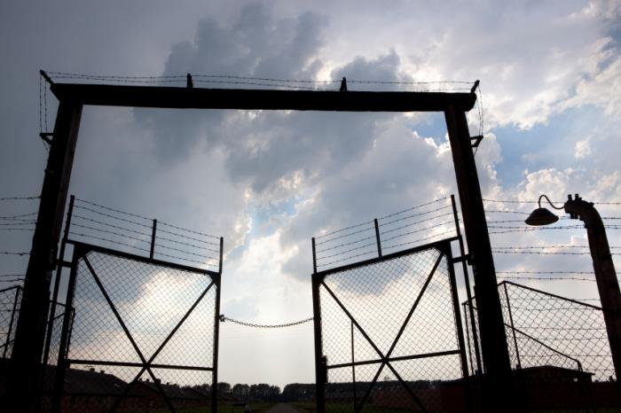
What if Cyril had gone to jail?
What would have happened?
Cyril would have served a sentence as guided by the courts at a jail appropriate to his perceived risk to the public
Following his release he would serve time under the guidance of the Probation Services
He would be advised to visit his local Job Centre to help him look for a job.
Cyril may have to apply for appropriate benefits online via gov.uk.
Notes:
Male prisoners are categorised as Category A, B, C, or D whilst females are only categorised as Open or Closed. These categorisations decide which establishment the prisoner will be located at to serve their sentence. Prisoners can be re-risk assessed during their sentence.
Probation Services now come under the jurisdiction of HMPPS (Her Majesty’s Prison & Probation Services). Probation assist those offenders who have been through the courts and help to rehabilitate them.
Civil Servants within the Prison Service can be operational (face to face contact with offenders/wear uniform) or can provide administrative support and leadership.
HMPPS comes under the directive of the Ministry of Justice which comes under the ministerial authority of the Secretary of State.

Slide 15
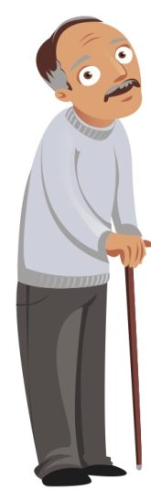

Cyril Retires
What happens now?
After a long career Cyril applies online for his state pension.
As he has paid enough National Insurance, he decides to retire and claim his state pension.
He could apply for pension credit if applicable.
He may be entitled to winter fuel allowance.

Slide 16
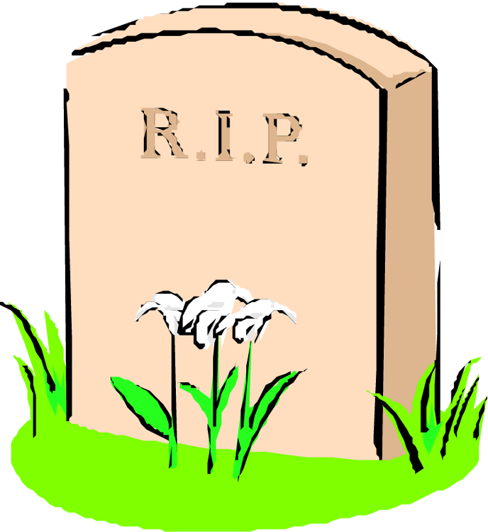
Cyril Dies
What happens now?
Death is registered and certificate issued so funeral can go ahead.
His family may be able to use Tell Us Once whom informs all departments of his passing.
His family can apply for a funeral payment and possibly other benefits.

Slide 17
Summary
Cyril’s journey from cradle to grave. He has connected with a variety of Civil Service departments throughout his life and the Civil Service has supported many of his major life events.
Could you help someone like Cyril?

Slide 18
What you can do for us?
We have many opportunities for you to come and work in one of our departments, e.g. front line case worker to computer programmer.
No matter if you’re planning to go to College or University, or if you want to get straight into work, we have something to suit everyone.
This includes:
The Civil Service Apprenticeship Scheme
The Fast Track Scheme
This presentation was designed and created by: Arlene Baker, Diane Redell, Christine Phillips, Jonathan Wright, Kurt Osborne, Lesley Hoyes and Megan Liversuch.

